Slide 1
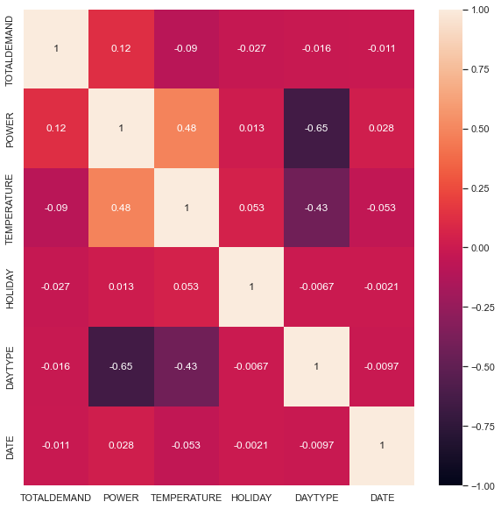
Data Set Correlation
Positive Correlation
No Relationship
Negative Correlation

Slide 2
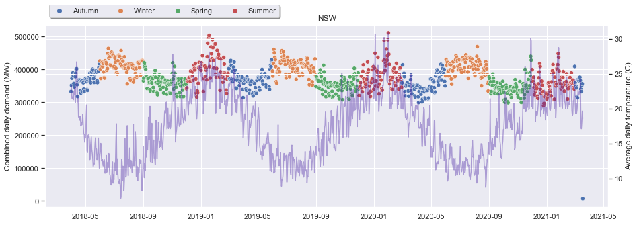
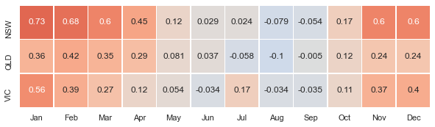
Relationship Between Temperature and Demand

Slide 3
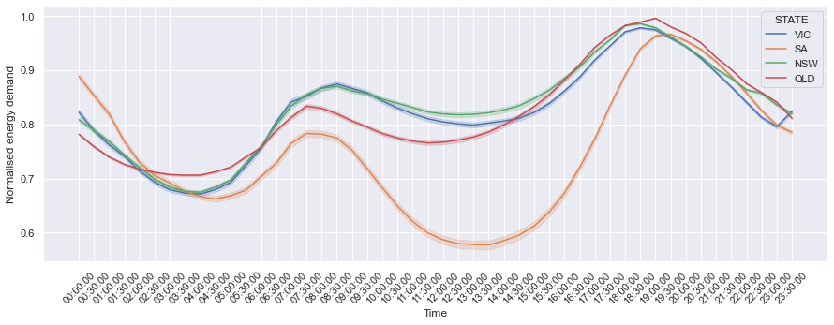
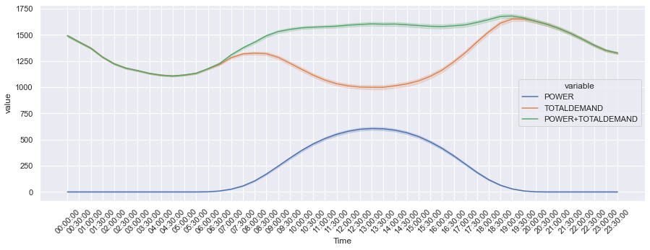
Relationship Between PV and Demand

